Slide 1



CACFP Meal Pattern
Presented by the Child Care Resource Center
Notes:
Welcome to the training the Child and Adult Care Food Program Child Meal Pattern. This training is presented by the Child Care Resource Center, your child care resource and referral agency and CACFP program sponsor. The information in this presentation applies to children age 1 and older. This training is required to participate in the CACFP and is intended for those serving meals. This training is intended to help you understand meal requirements and paperwork procedures for serving meals to children 1 year of age and older. There is a separate presentation about the meal pattern for infants.
Records indicating who received this training, the topics covered, and the date it was completed is maintained on the Ohio Professional Registry by the CCRC.
Before you proceed in the training, be sure you have the CACFP Handbook for Centers provided to your program by the Child Care Resource Center in front of you. Please refer to the USDA’s ”Crediting Handbook for the Child and Adult Care Food Program” from Section 6 of the CACFP Program Binder. This binder was provided to your center by the Child Care Resource Center. If you do not receive this binder, contact your CACFP representative at the Child Care Resource Center.

Slide 2
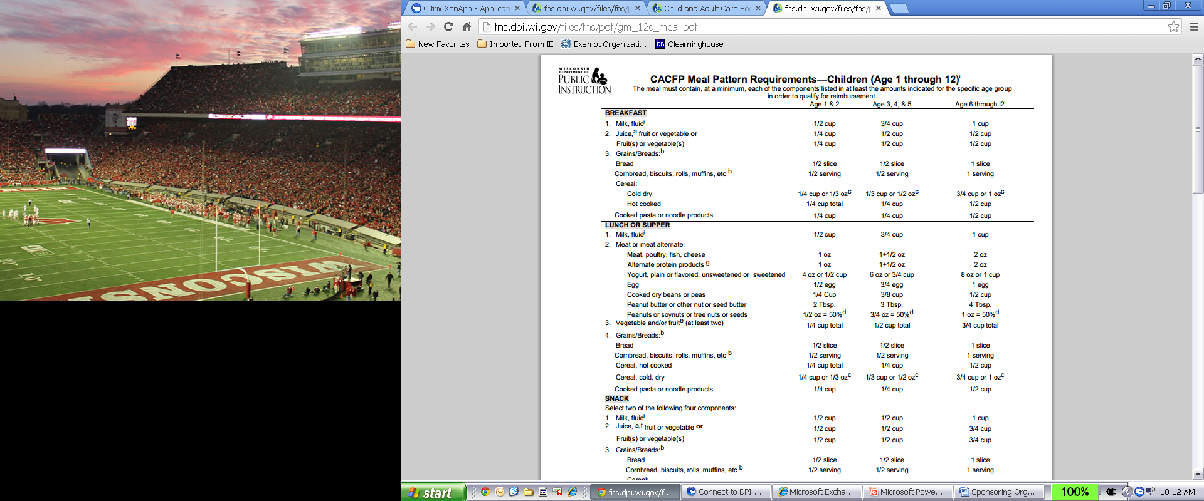
CACFP Meal Pattern for 1-2 year old
AGE GROUPS
MEAL COMPONENTS
Notes:
To begin, you need to understand what foods are included in each meal you serve. The CACFP calls these meal components. The CACFP meal pattern specifies what food and how much must be served as part of a creditable breakfast, lunch, supper, and snack.
On this slide is a snapshot of the breakfast meal pattern. On the left the required meal components are listed, and across the top are three different age groups: Ages 1 & 2, 3-5 and 6-12. Beneath each age group are the minimum amounts of each meal component that must be served for that age.

Slide 3
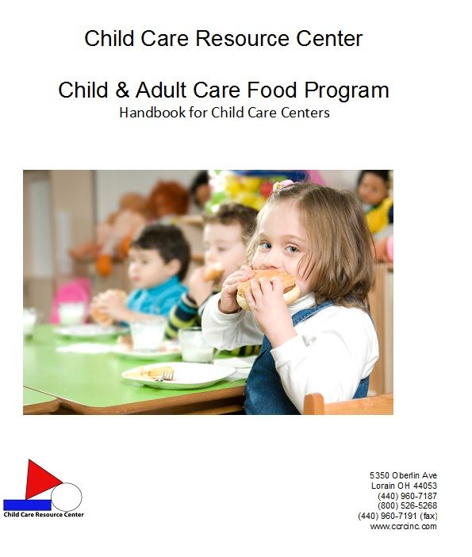
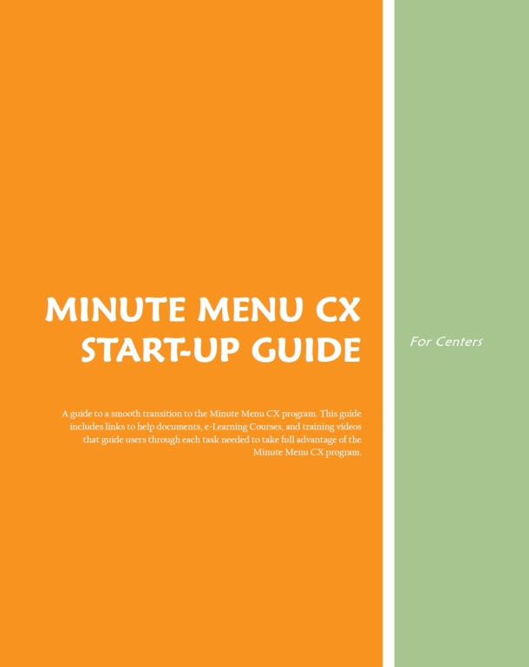
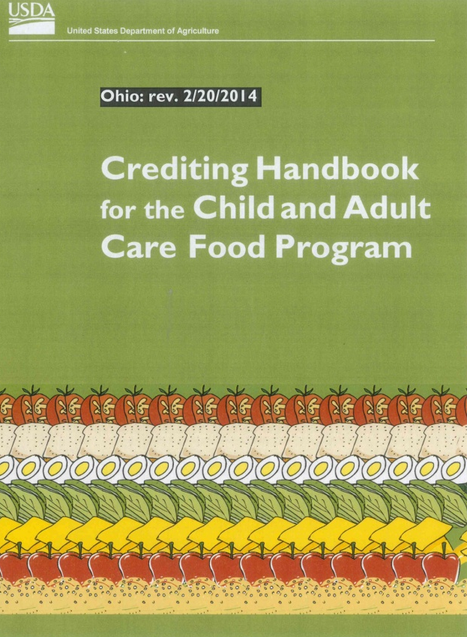
Handbooks for Creating Menus
Notes:
You will also use your CCRC Program Binder, the USDA Crediting Handbook, and the Minute Menu Handbook when creating menus.

Slide 4
Creditable & Non-Creditable Foods
Creditable Foods:
  Foods that may be counted toward meeting meal pattern requirements
  A meal is acceptable for CACFP if it contains creditable foods and serving sizes outlined by USDA
Non-Creditable Foods:
  Foods that do not count toward meeting meal pattern requirements
  Supply additional nutrients and calories that help meet energy and nutritional needs of participants
Notes:
Creditable Foods are foods that may be counted toward meeting the meal pattern requirements for a reimbursable meal. A meal is reimbursable if it contains creditable foods in the amounts indicated in the CACFP meal pattern.
Non-Creditable Foods are foods that do not count toward meeting meal pattern requirements because they do not meet USDA criteria. Non-creditable foods can still be served as extras because they often supply additional nutrients and calories that help meet the energy and nutritional needs of participants.

Slide 5
Breakfast
COMPONENT | AGES
 | 1-2 | 3-5 | 6-12
Milk | ½ cup | ¾ cup | 1 cup
Fruit / Vegetable or Juice | ¼ cup | ½ cup | ½ cup
Grains/Breads | ½ serving | ½ serving | 1 serving
Notes:
This is the breakfast meal pattern. Components required are milk, one fruit or vegetable or juice, and one grain/bread. The minimum serving amounts for each age group are shown here.

Slide 6
Lunch/Supper
COMPONENT | AGES
 | 1-2 | 3-5 | 6-12
Milk | ½ cup | ¾ cup | 1 cup
Meat/Meat Alternate | 1 ounce | 1½ ounces | 2 ounces
Fruits and/or Vegetables (2) | ¼ cup total | ½ cup total | ¾ cup total
Grains/Breads | ½ serving | ½ serving | 1 serving
Notes:
This is the lunch and supper meal pattern. Components required are milk, a meat or meat alternate, 2 fruits, 2 vegetables or one of each, and a grain/bread. You must serve milk at lunch and supper. Juice cannot replace milk at lunch or supper. You can also not replace milk with water. The minimum serving amounts for each age group are shown here.

Slide 7
Snack
COMPONENT Choose two: | AGES
 | 1-2 | 3-5 | 6-12
Milk | ½ cup | ½ cup | 1 cup
Meat/Meat Alternate | ½ ounce | ½ ounce | 1 ounce
Fruit/Vegetable | ½ cup | ½ cup | ¾ cup
Grains/Breads | ½ serving | ½ serving | 1 serving
Notes:
This is the snack meal pattern. A snack must contain foods from two of the four components. The minimum serving amounts for each age group are shown here.

Slide 8

Milk
CACFP Milk Requirements
Age 12-24 months | Whole | Required
Age 24 months and up | Low-fat (1%) or Fat-free (skim)* | Required
* Includes low-fat & non-fat forms of lactose reduced, lactose free, buttermilk or acidified milk
Notes:
Now let's review the individual food components.
Milk is a required component at breakfast, lunch and supper, and may be served as one of the two required components for snack.
The CACFP specifies the type of milk that must be served to different age groups. For children age 12 to 24 months, whole milk is required. Children age 24 months (2 years) and older must be served low-fat (1%) or non-fat (skim) milk. This includes the low-fat and non-fat forms of lactose reduced, lactose free, buttermilk, or acidified milk. 2% milk may not be served to children age 2 and older.

Slide 9

Milk
Only fluid milk is creditable
Breakfast / snack: Beverage, used on cereal or both
Snack: Not to be served when juice is the only other component
Notes:
Only fluid milk credits to the meal pattern. Milk may never be credited when cooked in cereals, puddings, or other foods.
At breakfast and snack, fluid milk can be served as a beverage, used on cereal or both
For snack, milk may not be served when juice is served as the only other component.

Slide 10

Non-Dairy Milk Alternatives
Families must request, in writing, that their child(ren) be served non-dairy milk substitutes. There is a form for them to use.
A medical statement IS NOT required.
The family MUST give a reason for requesting a non-dairy milk substitute.
The non-dairy milk substitute MUST be nutritionally equal to fluid dairy milk
Notes:
There are many kinds of “milk” now available, and many of them are creditable on CACFP. Children may be served non-dairy milk substitutes in place of fluid dairy milk without need for a medical statement.
You do not have to supply the non-dairy milk substitute. Families can supply the milk substitute* and you can still claim it for reimbursement. If you decide not to supply the milk substitute and require that families do it, put this in your handbook and let your families know right away.
Continue to code milk as you always have.

Slide 11
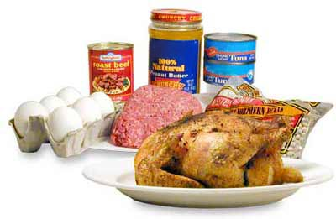
Meat/Meat Alternate
Meat | Poultry Seafood Lean meat (ground beef, pork loin, roasts)
Meat Alternate | Cheese Eggs Yogurt Cooked dry beans or peas Nuts and seeds* Peanut butter or other nut/seed butters Alternate protein products
* No more than one-half of the meat/meat alternate requirement for lunch & supper
Notes:
A meat or meat alternate is a required component at lunch and supper and may be served as one of the two required components for snack.
Meat choices include poultry, seafood and lean meats such as ground beef, pork loin and roasts.
Meat alternates include cheese, eggs, yogurt, cooked dry beans or peas, and nuts and seeds and their butters. Regular nuts and seeds may fulfill no more than one-half of the meat/meat alternate requirement for lunch and supper. A second item must be served.
Alternate protein products may be served if they meet the criteria for alternate protein products used in the CACFP.

Slide 12
Serving Amounts for Meat Alternates
Food | Amount | M/MA
Yogurt | 4 oz serving (½ cup) | 1 oz
Nut or Seed Butters | 2 Tablespoons | 1 oz
Cheese Food, Cheese Spread, Cottage Cheese, Ricotta Cheese | 2 oz serving | 1 oz
Natural Cheese Pasteurized Process Cheese | 1 oz serving | 1 oz
Imitation Cheese, Cheese Product Velveeta, Powdered Cheese | NOT CREDITABLE
Cheese Sauce | REQUIRES CHILD NUTRITION LABEL
Notes:
It is important to note different serving amount requirements for some meat alternate foods.
For nut or seed butters, 2 Tbsp equals 1 oz M/MA.
For yogurt, a 4 ounce serving, or ½ cup, equals 1 oz M/MA.
Cheese labeled as cheese food, cheese spread, cottage cheese and ricotta cheese are creditable to the meal pattern; however, because of the product’s content, 2 ounces must be served to equal 1 ounce of meat/meat alternate. Cheese labeled as natural cheese and pasteurized process cheese: 1 oz equals 1 oz of meat/meat alternate.
Cheese labeled as imitation cheese or cheese product, and Velveeta and powdered cheeses are not creditable and cannot be served to meet the meat/meat alternate requirement. Many cheese slices on the market are labeled as a cheese product, so, be sure to check the label when purchasing cheese slices and do not buy those labeled imitation cheese or cheese product. Powdered macaroni and cheese products are not creditable as a meat/meat alternate; however, the macaroni does credit as a grain/bread item.
Last, cheese sauce and products made with cheese sauce are not creditable unless supported by a Child Nutrition label or product formulation sheet, which provides information on how the item contributes to the meal pattern.
Yogurt or cheese cannot be claimed for the milk requirement.

Slide 13

Meat/Meat Alternate
  Lunch/Supper
    Must be serve as part of main dish OR
    In a main dish with one other item
  ¼ ounce is minimum amount that can be served
Notes:
During lunch and supper, the meat or meat alternate must be served as part of the main dish, or in a main dish and one other item.
When serving more than one meat or meat alternate food at the same meal, ¼ ounce is the minimum amount that can be served to count toward the meal pattern.

Slide 14
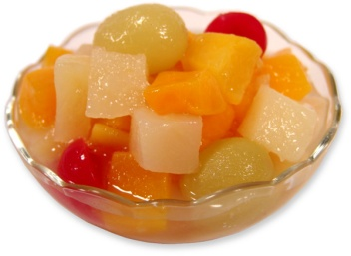

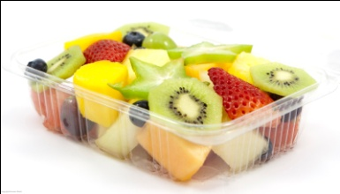
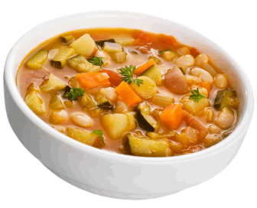

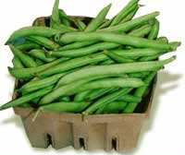
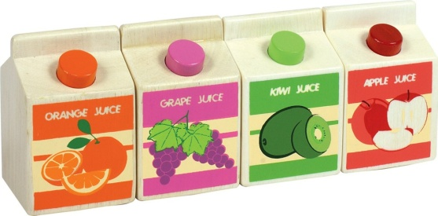
Fruits and Vegetables
Fruits
Vegetables
100% Fruit Juices
Remember: Potatoes are a vegetable (Baked, mashed, roasted, hash browns, french fries, tater tots)
Notes:
Fruits and vegetables are a required component at breakfast, lunch and supper, and may be served as one of the two required components for snack.
Lunch and supper must contain two different vegetables, two different fruits, or one of each. One of these servings can be 100% full-strength juice.
Note that the CACFP meal pattern classifies potatoes and potato products as a vegetable, not a grain/bread. This includes all forms of a potato.

Slide 15

Fruits and Vegetables
Lunch/Supper:
  Combination fruit or vegetable products (fruit cocktail, mixed fruit or mixed vegetables) are considered to be one fruit or vegetable
Snack:
  Two fruits, two vegetables or one of each (including juice) cannot be the only two items
  Juice is not to be served when milk is the only other component
Notes:
At lunch and supper, combination fruit or vegetable products that contain more than one fruit or vegetable, such as fruit cocktail, mixed fruit or mixed vegetables, are considered to be one fruit or vegetable. Another fruit or vegetable must be served.
At snack, two fruits, two vegetables, or one of each, including juice, cannot be served as the only two items. A different component must be served with a fruit or vegetable. Also, juice may not be served as one of the snack components when milk is served as the only other component.

Slide 16
Fruits and Vegetables
Cooked dry beans or peas are a vegetable or a meat alternate, not both in the same meal
Small amounts (less than 1/8 cup) and garnishes do not count toward the meal pattern
Notes:
Cooked dry beans or peas are part of both the fruit/vegetable component and the meat/meat alternate component. When served at a meal they may be counted as a vegetable or as a meat alternative, but not as both.
Last, for all meals, when serving more than one fruit or vegetable, small amounts (less than 1/8 cup) and garnishes do not count toward the meal pattern.

Slide 17
Serving Amounts for Fruits and Vegetables
Food | Serving Size & Yield
Carrot Sticks | 1 stick is 4 inches long and ½ inches wide 3 sticks = ¼ cup
Cauliflower | 1 medium head = about 6 cups florets Serving = ¼ cup cooked or raw florets
Celery Sticks | 1 stick is 4 inches long and ¾ inches wide 3 sticks = ¼ cup
Cucumber Sticks Peeled or Unpeeled | 1 stick = 3 inches long and ¾ inches wide 1 cucumber = 12 sticks 3 sticks = ¼ cup
Radishes | 7 small radishes = ¼ cup
Medium Tomato Slices | 2 1/8 -2 ¼ inch diameter tomato; 5 slices, 1/8 thick
Cherry Tomatoes | 5 half cherry tomatoes = ¼ cup 3 whole cherry tomatoes = ¼ cup
Notes:
Just like all other meal components, it is important to also be aware of what is meant by serving sizes for fruits and vegetables. As adults we often misjudge appropriate serving sizes and offer to little or too much. You should also remember that the CACFP serving sizes are the minimum amounts required. You must offer at least the minimum but you can provide more to a child who is still hungry.
This is a list of some common fruits and vegetables and a guide for serving sizes. Please note that these serving sizes and yields are approximate since the size and weight of raw fruits and vegetables can vary. It is intended to be a reference only. You still want to double check that you are meeting serving sizes as you are preparing the meals and serving the individual children.

Slide 18
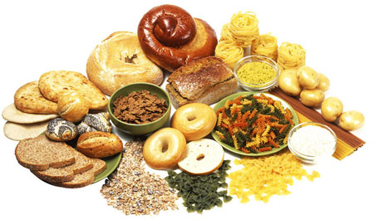
Grains and Breads
Primary grain ingredient is whole-Grain or enriched
Breads | Sliced bread, biscuit, roll, muffin, pancakes, waffles, etc
Grains | Hot and cold cereals, rice, pasta, granola bars, crackers, tortilla, etc.
Notes:
A grain/bread item is a required component at breakfast, lunch and supper, and may be served as one of the two required components for snack.
Grain/bread choices include breads and bread-like items such as biscuits, rolls and muffins. Other items include crackers, hot and cold cereals, rice, pasta, waffles, tortillas, pancakes and granola bars.
Foods may be credited as a grain/bread when the primary grain ingredient is whole-grain or enriched or is made from whole-grain or enriched meal and/or flour.

Slide 19
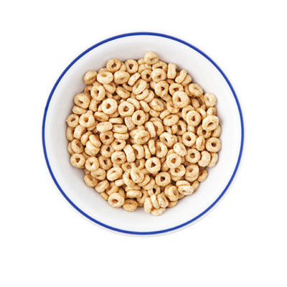

Grains/Breads
½ or 1 serving of one item can be less than ½ or 1 serving of a similar item of a different size
Notes:
For many grain/bread items, the CACFP meal pattern specifies that a child be served ½ serving or 1 serving of that item. For foods that can be purchased in different sizes, such as bagels that can be purchased in mini, regular and jumbo sizes, this means serving different amounts of the item depending on what size you buy since half of a mini bagel provides less food than half of a jumbo bagel.
Similarly, ½ or 1 serving of an item does not just mean that you give a child ½ or 1 item. The amount of grain in an item determines how much of the item you need to serve to meet the meal pattern.
If you are responsible for menu planning at your center, you will receive more extensive training on how to figure out correct portion sizes for different foods.

Slide 20
Common Non-Creditable Items
Popcorn
Jelly/jam
Ice cream
Frozen yogurt
Sherbet
Pudding
Fruit snacks
Tofu / Tempeh
Lemonade
Cranberry juice cocktail
Velveeta™
Cream cheese
Sour cream
Jell-O ™
Notes:
This list shows common food items served that are not creditable to the meal pattern and may only be served as extras. Please note that this list is not all-inclusive. To determine if a food is creditable to the meal pattern you should use Minute Menu and your CACFP Handbooks provided to you.

Slide 21
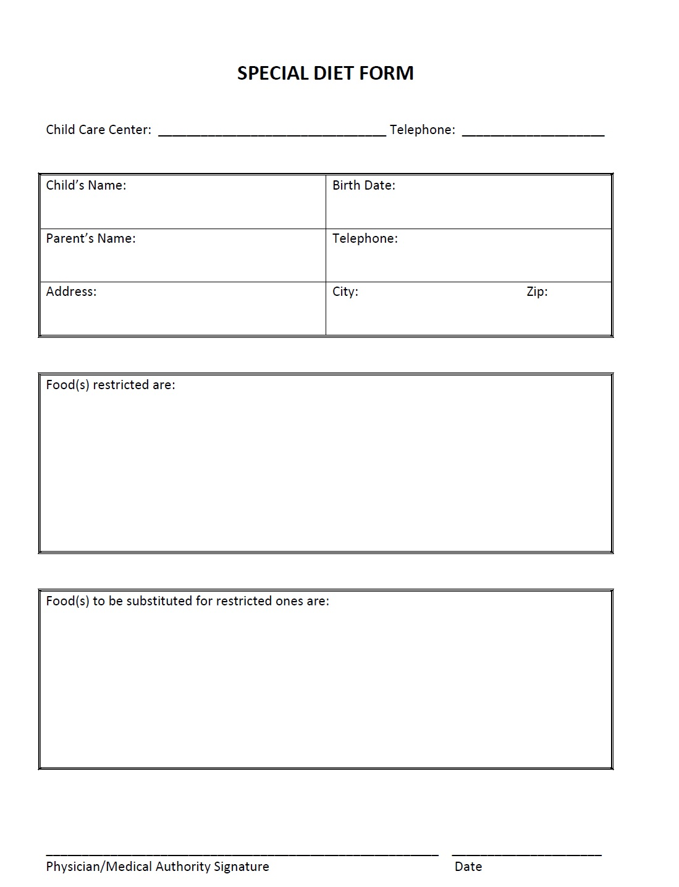
Special Diets- Disability
A center is required to provide food substitutions or make modifications in meals for children whose food allergies become a disability or when other disabilities restrict their diets
A medical statement signed by a licensed physician must be on file
Notes:
Next let’s discuss what to do when a child in your care has a special dietary need.
When a food allergy becomes a disability or when other disabilities restrict a child’s diet, a center is required to provide food substitutions or make modifications in meals for those children.
The disability will need to be supported by a statement signed by a licensed physician.
If you are the person at your center responsible for planning meals or the person responsible for managing children’s records, you will receive more extensive training on Special Diets and the record-keeping needed.

Slide 22
Child Care Resource Center Contact Information
5350 Oberlin Ave Lorain OH 44053
(440) 960-7187 or (800) 526-5268
(440) 960-7191 (Fax)
centercacfp@ccrcinc.com
CACFP Team:
Martha Deavers Ext 232
Notes:
This concludes the presentation on CACFP Child Meal Pattern. If you have any follow up questions or need further directions, please don’t hesitate to contact us.

Slide 23

In accordance with Federal Law and U.S. Department of Agriculture policy, this institution is prohibited from discriminating on the basis of race, color, national origin, sex, age, or disability.
To file a complaint of discrimination, write USDA, Director, Office of Adjudication, 1400 Independence Avenue, SW, Washington, D.C. 20250-9410 or call toll free (866) 632-9992 (Voice). Individuals who are hearing impaired or have speech disabilities may contact USDA through the Federal Relay Service at (800) 877-8339; or (800) 845-6136 (Spanish).
USDA is an equal opportunity provider and employer.
Notes:
Thank you for watching this webcast discussing the CACFP Child Meal Pattern. Be sure to complete our other webcasts about the CACFP at www.ccrcinc.com.

