Slide 1



Point of Service:
Meal Counts and Attendance
Presented by the Child Care Resource Center
Notes:
Welcome to the webcast, Point of Service: Meal Counts and Attendance for the CACFP presented by the Child Care Resource Center. We are your childcare resource and referral agency and your sponsor for the Child and Adult Care Food Program. This webcast will guide you through the process of correctly recording and maintaining point of service meal counts. It is required for any center staff responsible for recording meal counts and attendance for the children in your classroom and/or center.
Before you begin this session, please have your CACFP Handbook for Center available and open to page 28 and 29. The CACFP Handbook for Centers is provided to you by the Child Care Resource Center. If you do not have this handbook, contact your CACFP representative at the Child Care Resource Center.

Slide 2
CACFP Meal Counts
Your agency is reimbursed for the number of meals and snacks it serves to CACFP enrolled children each day
Meal counts must be recorded daily at the time of each meal or snack service
This is called the Point of Service Meal Count
Notes:
Your center is reimbursed for the number of meals and snacks you serve to CACFP-enrolled children each day. To properly claim these meals and snacks, meal counts must be recorded either at the time of each meal or snack service. This is called the Point of Service Meal Count.

Slide 3
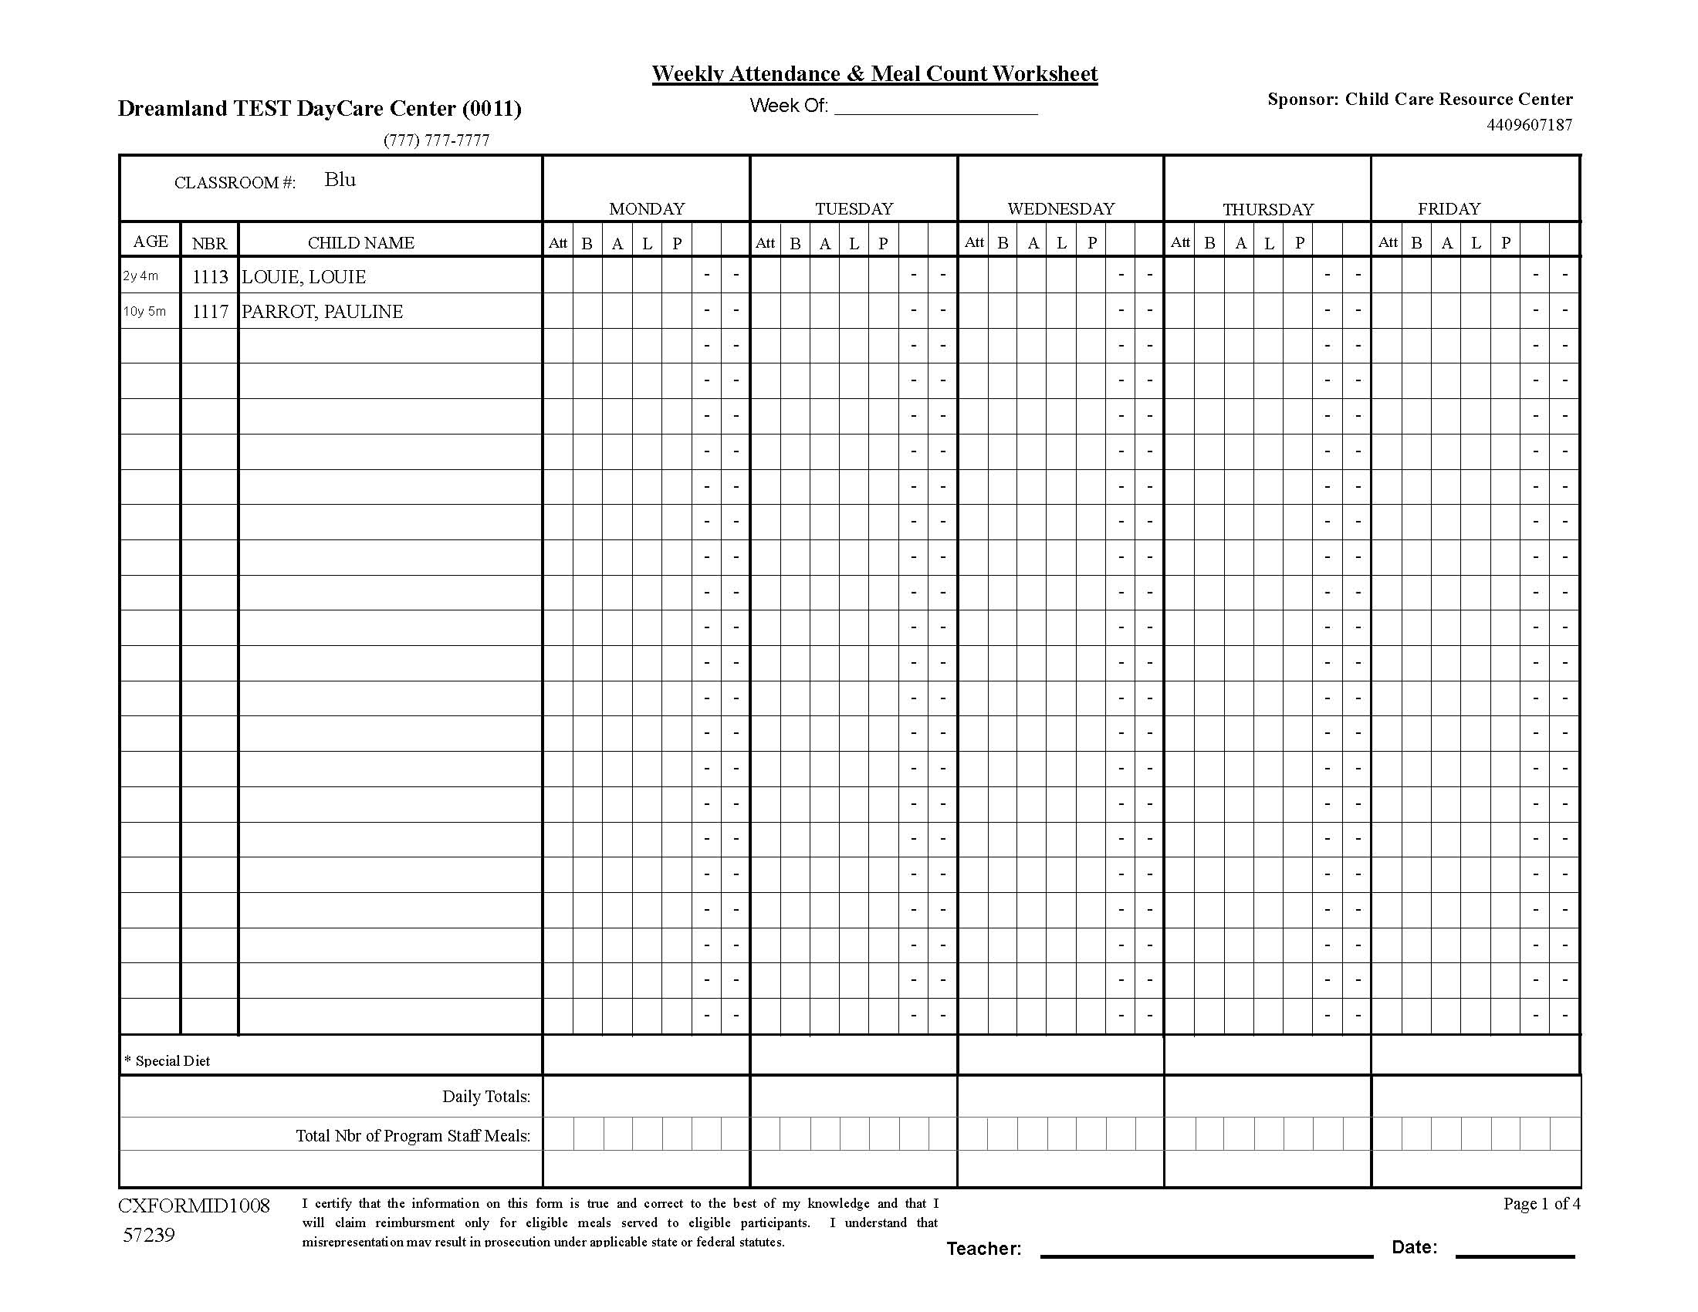
Daily Participation Record and
Monthly Meal Count Summary
Notes:
The Daily Participation Record and Monthly Meal Count Summary form can be printed from Minute Menu and should be used to record meal counts. Throughout the remainder of this webcast, this form will be referred to as the Meal Count form.
Along the left hand side of the form are age of each child, their Minute Menu number and child’s name. Across the top row are the different meal services. You will record meal counts only for those meals and snacks you have been approved. The attendance column is there for you to record the total number of children in attendance that day.

Slide 4
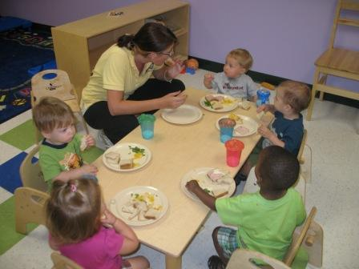
Point of Service Meal Count Procedure
Trey
Matthew
Andrew
Marcus
Kayla
Notes:
You complete the point of service meal count at meal time, when children are sitting and have been provided a complete CACFP reimbursable meal or snack. You must record meal counts by child.
On this slide we have Andrew, Trey, Matthew, Marcus and Kayla eating a meal.

Slide 5
Point of Service Meal Count Procedure: Recording Meal Counts
Mark the lunch for each child eating on Meal Count Record for LUNCH:
Andrew
X
Trey
X
Kayla
X
Matthew
X
Marcus
X
Notes:
On the meal count form we record this meal count by putting an X in the appropriate box for that meal for each child. Therefore, Andrew, Trey, Matthew, Marcus and Kayla all get an X by their name for lunch on this day.

Slide 6
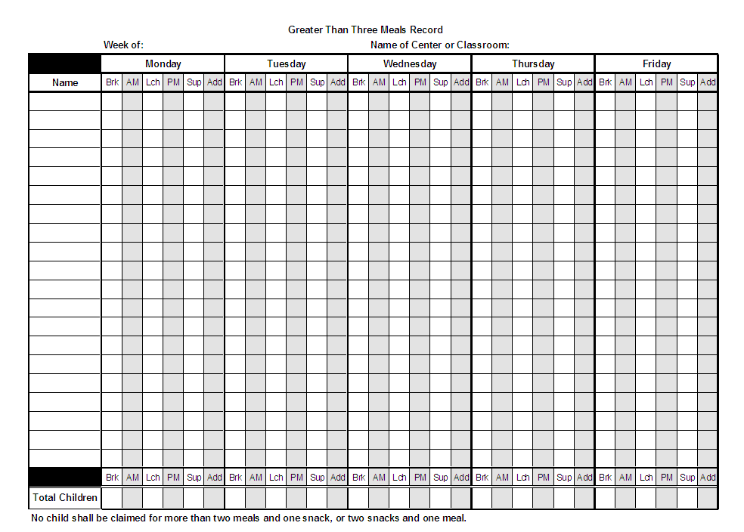





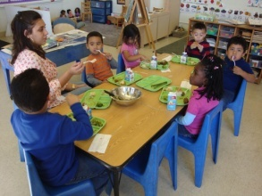
Point of Service Meal Count: Center Environment
Common Eating Area
Eating in Classrooms
Notes:
Depending on your center’s environment, you may need to maintain one or multiple meal count forms.
Give each classroom teacher the page or pages that are relevant to that class. If you serve all your children together in the same room, then there’s no need to assign children to separate classrooms. So, feel free to organize your children into any classroom you find appropriate.

Slide 7
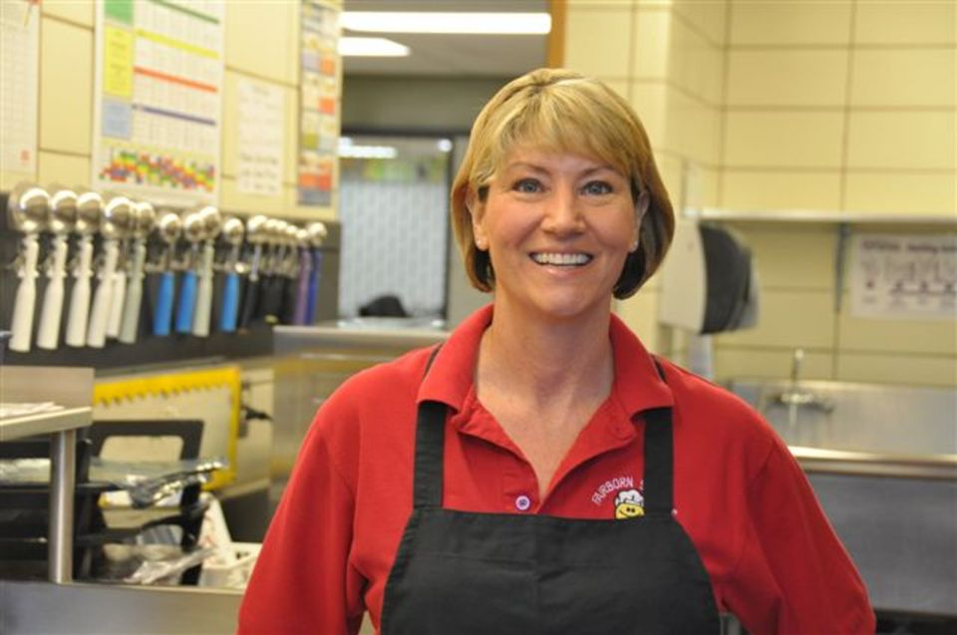

Point of Service Meal Counts:
Who Will Complete?
Common Eating Area
Cook
Director
Lead Teacher
Eating in Classrooms
Teachers
Notes:
You should also designate who will complete the meal counts each day. You may only want one person, such as the cook, director or a lead teacher, to be responsible for recording meal counts if all children eat in one common area. On the other hand, if children are eating in multiple locations or at different times, you may want all teachers to record meal counts.

Slide 8
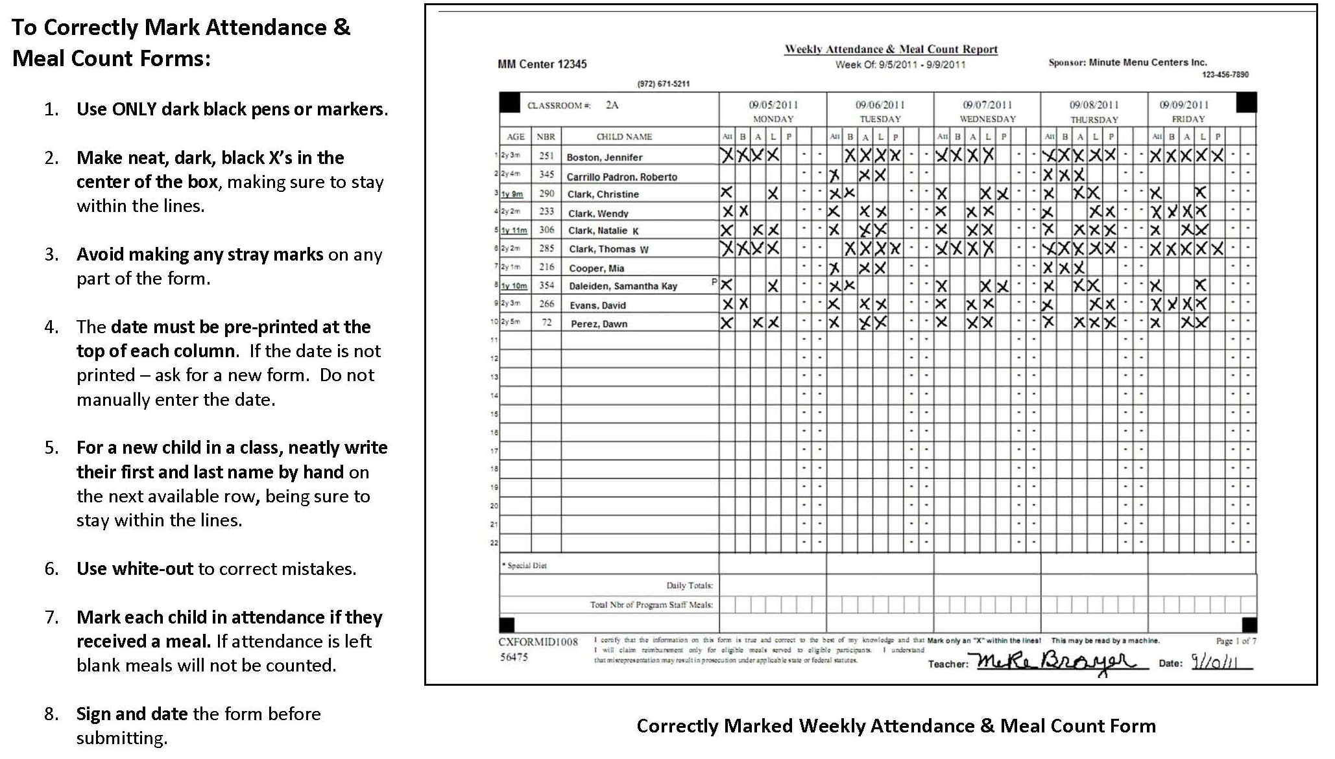
Properly Marking Attendance & Meal Counts
Notes:
Each day, the teacher checks each box when a child is served a meal and check the box for any child in attendance for the day overall, even if not fed. The teacher or other staff member filling out the form should sign the form on the bottom before submitting it to the person in charge of the CACFP at your center at the end of the week. Other points you should follow to ensure your form is completed correctly are:
Use only dark pens or markers
Make neat, dark, black’s in the center of the box
Avoid making any stray marks
The date must be pre-printed at the top of each column
For a new child, neatly write their first and last name by hand
Use write out for any mistakes
Mark each child in attendance if they received a meal
Sign and date before submitting it

Slide 9
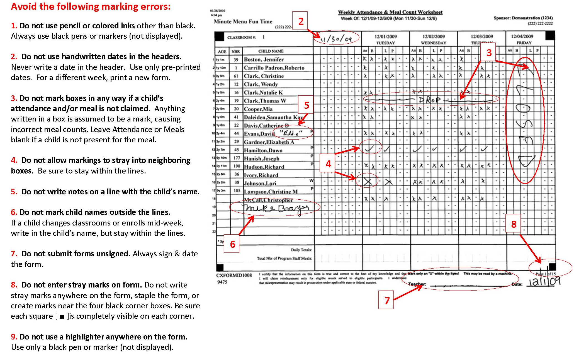
Common Errors in Filling Out the Form
Notes:
Be sure to stay away from issues with your forms by also avoiding some common errors in filling out the Meal Count Form.
Do not use pencil or colored inks other than black ink.
Do not use handwritten dates in the headers of the columns.
Do not mark boxes in any way if a child’s attendance and/or meal is not claimed.
Do not allow markings to stray outside the lines of the boxes.
Do not write notes on a line with the child’s name (such as nicknames, etc).
Do no mark child’ names outside the lines.
Do not submit forms unsigned.
Do not enter any stray marks anywhere on the form.
Do not use a highlighter pen or marker anywhere on the form.

Slide 10
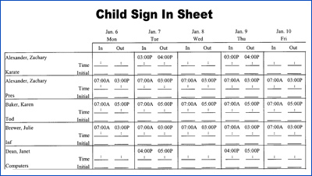
Meal Counts Cannot Be…
Based on computerized or daily attendance records
This does not meet the definition of a Point of Service Meal Count
Notes:
Meal counts must be completed at the point of service. Meal Counts cannot be based on computerized or daily attendance records that assume children have been served a meal or snack based on times of attendance. This does not meet the definition of a point of service meal count and must not be used as the source for determining the number of meals or snacks served to children.

Slide 11
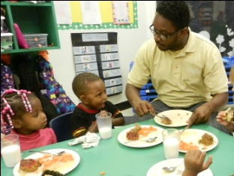
Center Staff/Family Meals
Adults may eat meals and snacks with children; however, their meals and snacks cannot be claimed for reimbursement
Notes:
Lastly, adults may eat meals and snacks with children; it is actually a positive experience for children and teachers or other adults to eat meals together. Adults become role models for eating habits and it supports children’s social development. However, meals and snacks the adults eat cannot be claimed for reimbursement.
Do not record adult meals and snacks on the meal count form.

Slide 12
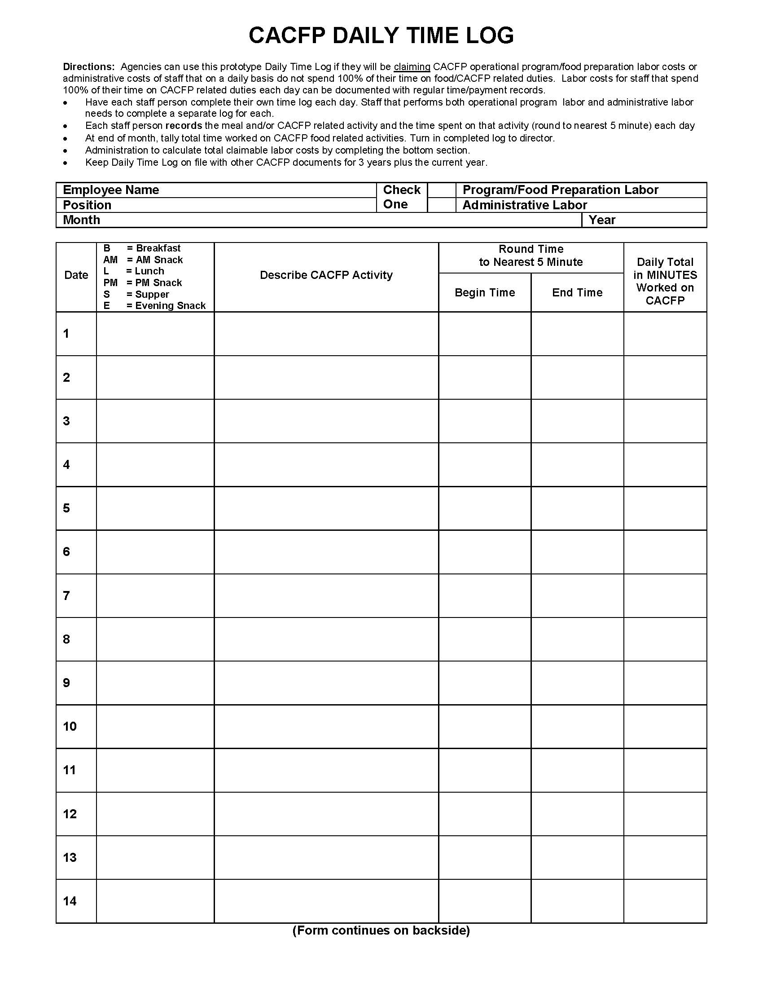
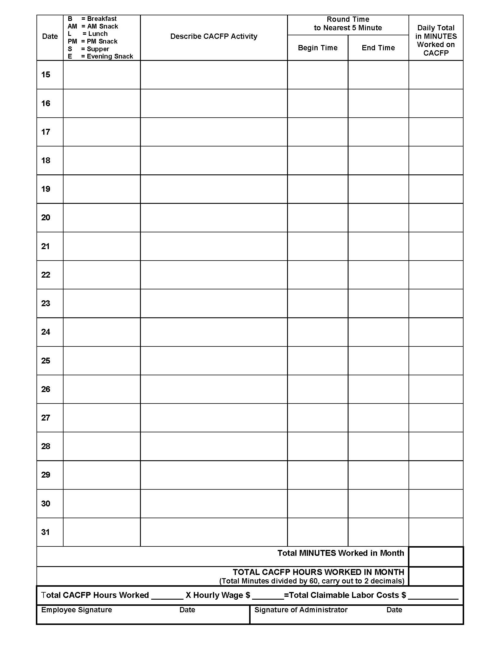
CACFP Daily
Time Log
Notes:
Finally, in addition to recording attendance and meal counts, each staff member must complete the monthly CACFP Daily Time Log. Each staff person completes their own time log each day. Staff that performs both operational program labor and administrative labor needs to complete a separate log for each. Each staff person records the meal and/or CACFP related activity and the time spent on that activity each day. You will round the time to the nearest 5 minutes.
This form tracks the time staff spend on CACFP activities, like tracking attendance and meal counts. This form is submitted to the person in charge of CACFP activities at your center.
(For trainer – slide animated. Starts with first side of Daily Time Log and transitions to show back side of form.)

Slide 13
Non-Discrimination Statement
In accordance with Federal Law and U.S. Department of Agriculture policy, this institution is prohibited from discriminating on the basis of race, color, national origin, sex, age, or disability.
To file a complaint of discrimination, write USDA, Director, Office of Adjudication, 1400 Independence Avenue, SW, Washington, D.C. 20250-9410 or call toll free (866) 632-9992 (Voice). Individuals who are hearing impaired or have speech disabilities may contact USDA through the Federal Relay Service at (800) 877-8339; or (800) 845-6136 (Spanish).
USDA is an equal opportunity provider and employer.
Notes:
In closing the USDA works to ensure no discriminatory practices are used, intentionally or unintentionally. The USDA and the State of Ohio are equal opportunity providers and employers.

Slide 14
Child Care Resource Center
Contact Information
5350 Oberlin Ave Lorain OH 44053
(440) 960-7187 or (800) 526-5268
(440) 960-7191 (Fax)
centercacfp@ccrcinc.com
CACFP Team:
Martha Deavers Ext 232
Notes:
This concludes the presentation on CACFP Point of Service Meal Counts and Attendance procedures. If you have any follow up questions or need further directions. Please don’t hesitate to contact us if you have any questions.

Slide 15

In accordance with Federal Law and U.S. Department of Agriculture policy, this institution is prohibited from discriminating on the basis of race, color, national origin, sex, age, or disability.
To file a complaint of discrimination, write USDA, Director, Office of Adjudication, 1400 Independence Avenue, SW, Washington, D.C. 20250-9410 or call toll free (866) 632-9992 (Voice). Individuals who are hearing impaired or have speech disabilities may contact USDA through the Federal Relay Service at (800) 877-8339; or (800) 845-6136 (Spanish).
USDA is an equal opportunity provider and employer.
Notes:
Thank you for watching this webcast discussing the CACFP Point of Service Meal Counts and Attendance. Be sure to complete our other webcasts about the CACFP at www.ccrcinc.com.

